Slide 1

WELCOME

Slide 2


MURUGAPPA POLYTECHNIC COLLEGE SATHYAMURTHY NAGAR, CHENNAI-62
DEPARTMENT OF ELECTRONICS
(ROBOTICS)
REVIEW-I
PROJECT JULY 2022- NOVEMBER 2022

Slide 3
PROJECT TITLE :
GEOFENCING AND SOIL MOISTURE MEASURING DEVICE (GSMM) FOR AGRICULTURE

Slide 4
LIST OF STUDENTS
S.NO ROLL.NO REGISTER.NO NAME OF THE STUDENT PROJECT GUIDE
1. 219272 1912447 A. Harish
2. 219276 1912451 T. Kumar Mr. P. Kalaiselvan,
3. 219284 1912459 K. Rubesh Lecturer / E(R)
4. 219298 1912473 S. Vishnu

Slide 5
MONTHLY ACTIVITY
MONTHS | WEEK 1 | WEEK2 | WEEK3 | WEEK4
JULY | - | - | - | -
AUGUST | COMPONENTS SELECTION | COMPONENTS SELECTION | COMPONENTS PURCHASED | COMPONENTS PURCHASED
SEPTEMBER | PROGRAMMING STARTED | COMPONENTS PURCHASED | PROGRAMMING | FRAME MAKING
OCTOBER | REPORT STARTED | ASSEMBLY | ASSEMBLY | REPORT MAKING
NOVEMBER | PROBLEM CORRECTION | SOFT BINDING THE REPORT

Slide 6
Components Purchased
Arduino uno
Servo motor
Lcd display
Relay module
Moisture sensor
Buzzer
Motor with pump
Solenoid valve
I2C Module
AC to DC Adapter
Float sensor
IR Sensor

Slide 7
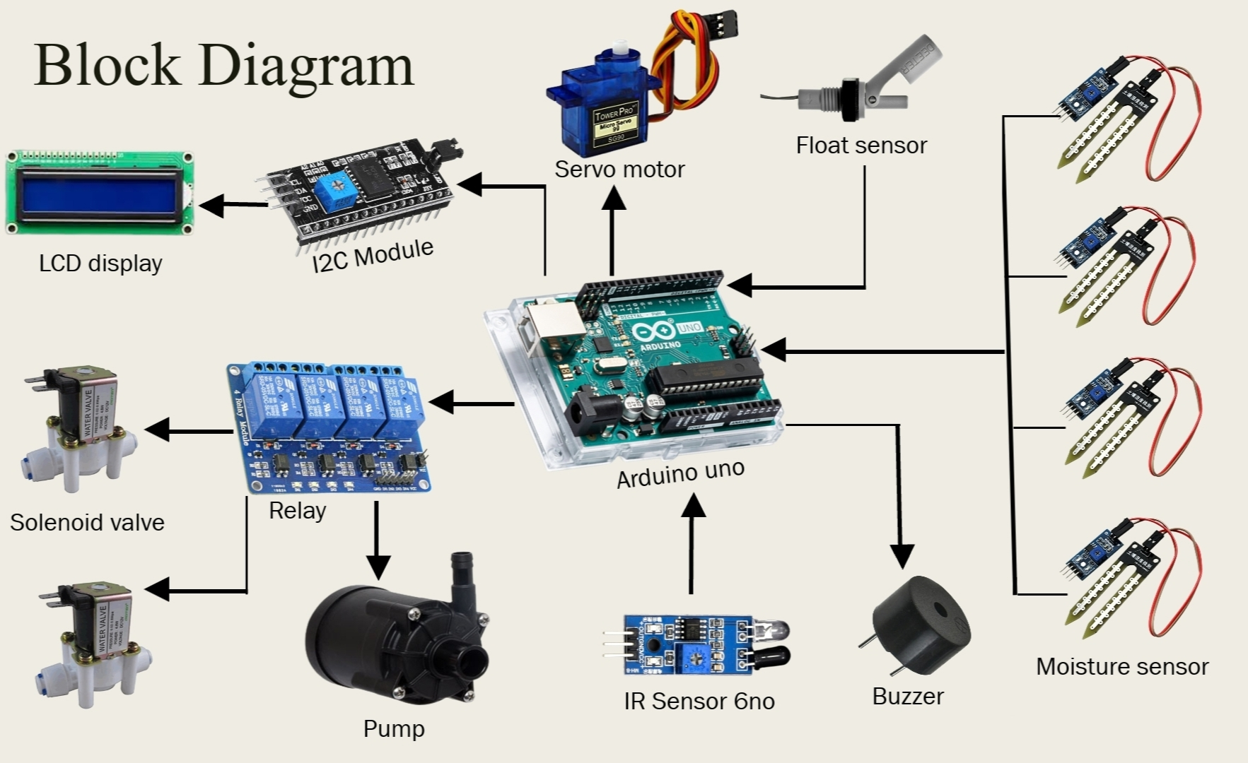

Slide 8
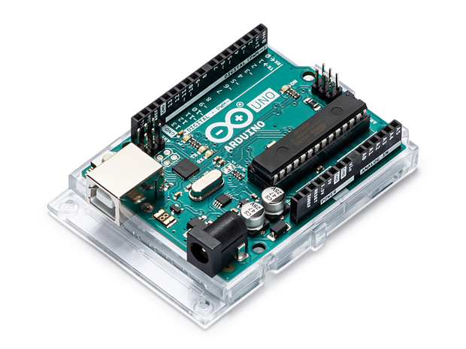
Arduino UNO
The main controller of this project is Arduino uno.
It has 14 digital I/O pins and 6 analog pins.
Arduino Uno is a microcontroller board based on the ATmega328P.
Fig No:1 Arduino UNO

Slide 9
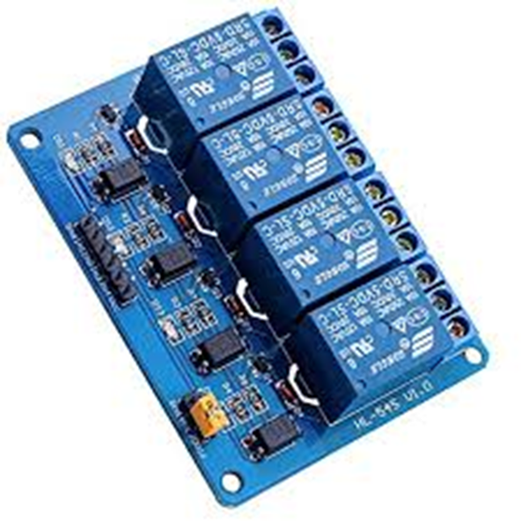
Relay Module
This is 5v 4-channel relay module.
It is used to control high voltage, high current load such as motor, solenoid valves, lamps, buzzer.
It is designed to interface with microcontroller such as Arduino, PIC and etc.
Fig No:2 Relay Module

Slide 10
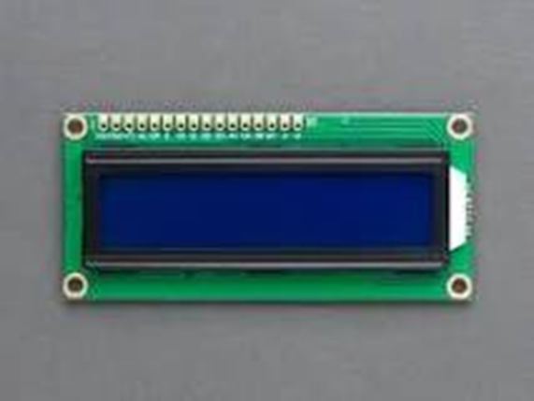
Lcd Display
This is 16x2 LCD Display.
A 16x2 LCD means it can display 16 characters per line and there are 2 such lines.
It is used to indicate the direction of animal entered into the field.
Fig No:3 Lcd Display

Slide 11
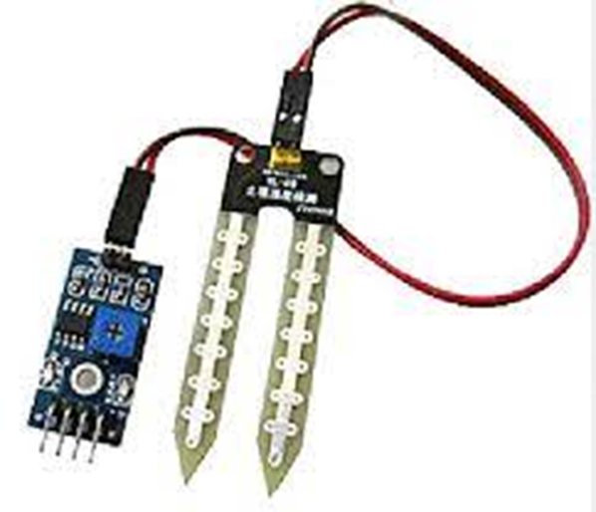
Moisture Sensor
This is FC-28 soil moisture sensor.
It is used to measure the moisture level of the soil.
The output of the soil moisture sensor changes in the range of ADC value from 0 to 1023.
Fig No:3 Moisture Sensor

Slide 12
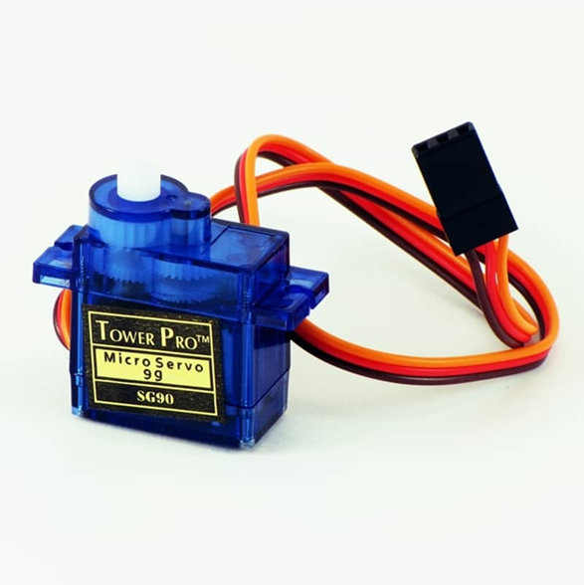
Servo Motor
This is used to open the ridges in field to drain the water due to heavy rainfall.
Servo motor is a component that can rotate its handle (usually between 0° and 180°).
It used to control the angular position of the object.
Fig No:5 Servo Motor

Slide 13
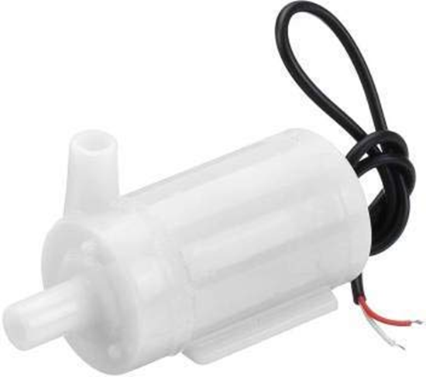
Motor with Pump
It is used to pump the water to irrigate the field.
This Motor operating with 12v dc power supply.
Fig No:6 Motor with Pump

Slide 14
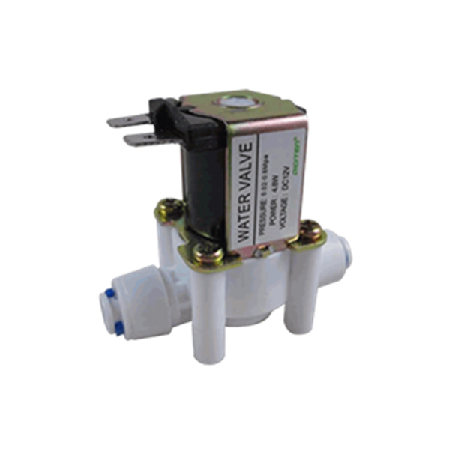
Solenoid Valve
Solenoid valve is used to restrict the water flow in the agriculture land.
The operating volt of this solenoid valve is 12 volt.
Solenoid valves are the most frequently used control elements in fluidics.
Outlet of the motor is directly coupled to this valve.
Fig No:7 SOLENOID VALVE

Slide 15
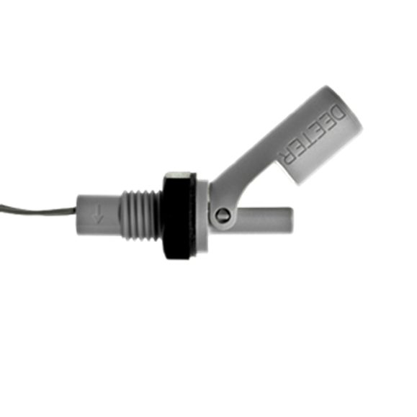
FLOAT SENSOR
Float sensor is used to detect the excess of water flow due to heavy rainfall.
Float level sensors are continuous level sensors featuring a magnetic float that rises and falls as liquid levels change.
The movement of the float creates a magnetic field that actuates a hermetically sealed reed switch located in the stem of the level sensor, triggering the switch to open or close.
Fig No:8 FLOAT SENSOR

Slide 16
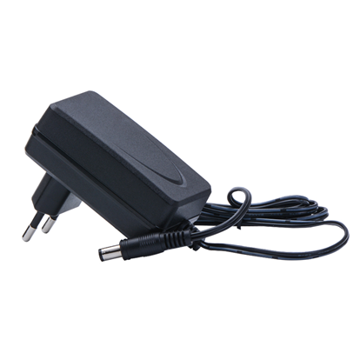
AC to DC Converter
It is used to convert 240v Alternating current into 12v Direct current.
AC to DC converter is used to power up the total device.
Fig No:9 AC to DC Converter

Slide 17
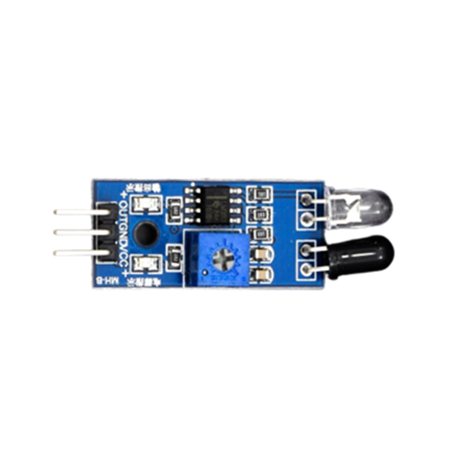
IR Sensor
Here IR Sensor is used to detect the entry of animals in agricultural field.
IR stands for Infrared sensor.
Fig No:10 IR SENSOR

Slide 18
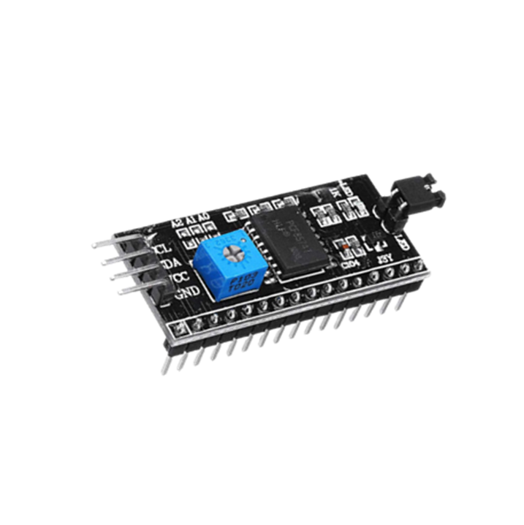
I2C Module
I2C uses only two bidirectional open collector or open drain lines, Serial Data Line (SDA) and Serial Clock Line (SCL), pulled up with resistors.
It is used to minimize the no of pin while interfacing Arduino uno and LCD display.
Fig No:11 I2C Module

Slide 19
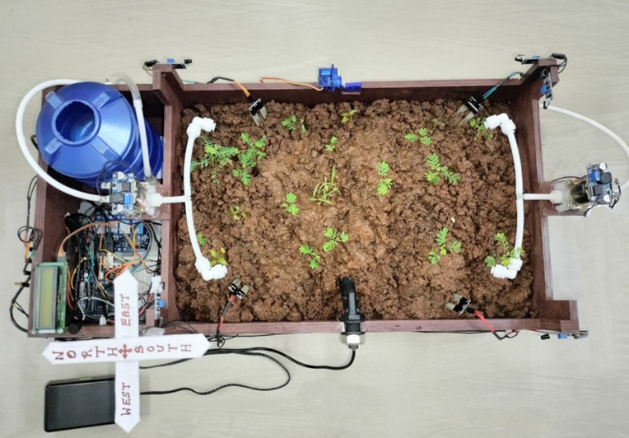
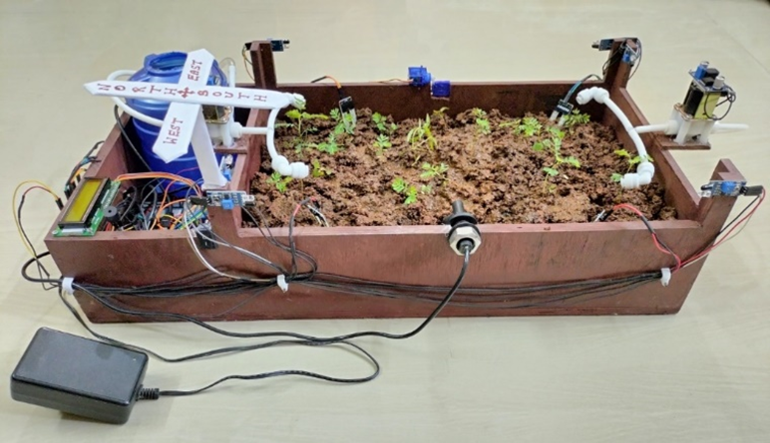
Project Photo
Fig no:2.13 Top View of Project
Fig no:2.12 Side View of Project

Slide 20

Project working video

Slide 21


